Slide 1

AWS Costs Breakdown
A Comprehensive Analysis
July 2025

Slide 2

Understanding Your AWS Spend
Cloud cost management is a critical aspect of
maintaining operational efficiency in today's digital
landscape. Understanding your AWS expenditure
provides valuable insights into resource utilization and
helps identify opportunities for optimization.
Identify cost trends and patterns
Pinpoint major cost contributors
Discover optimization opportunities
Balance performance and expenditure

Slide 3
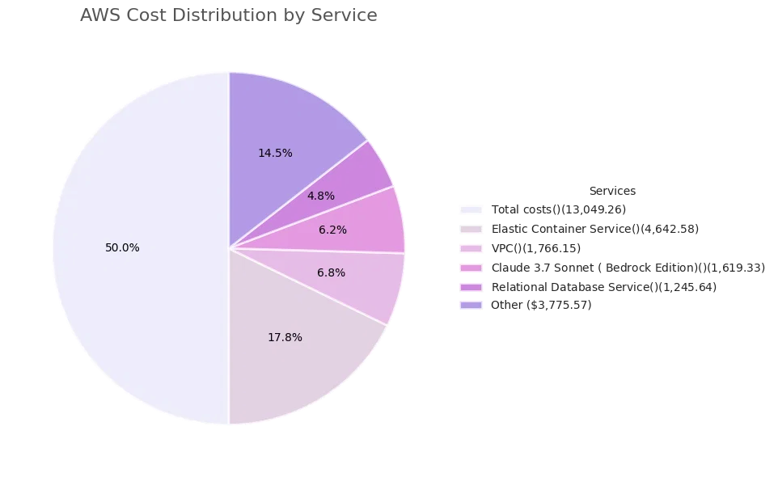
Total AWS Expenditure
Analysis of the AWS cost data reveals the distribution of
expenditure across various services. Understanding this
breakdown is essential for effective cost management
and optimization.
Total AWS Cost: $13,049.26
Elastic Container Service accounts for 35.6% of total
costs
VPC and networking services represent 13.5% of
expenditure
AI services (Claude models) comprise 12.4% of costs
Database services account for 9.5% of total spending

Slide 4

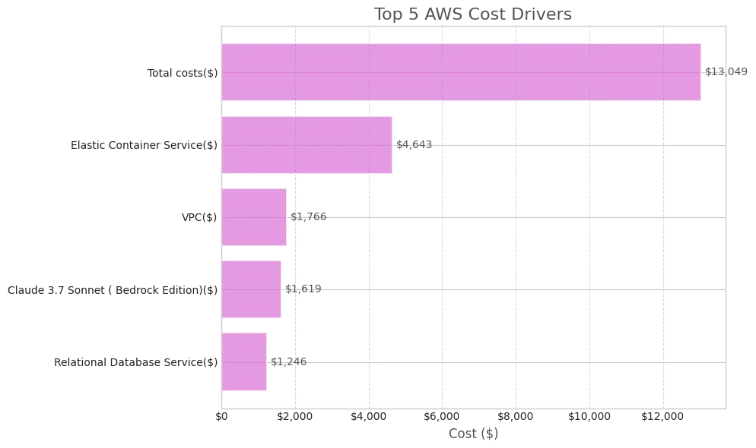
Identifying Key Cost Contributors
Five services account for over 80% of the total AWS
expenditure. Understanding these key cost drivers is
essential for targeted optimization efforts.
1. Elastic Container Service: $4,642.58
Container orchestration service for running and managing
Docker containers
2. Virtual Private Cloud: $1,766.15
Networking service for isolating cloud resources
3. Claude 3.7 Sonnet: $1,619.33
AI language model service via Amazon Bedrock
4. Relational Database Service: $1,245.64
Managed database service for SQL databases
5. Tax: $1,077.43
Applicable taxes on AWS services

Slide 5
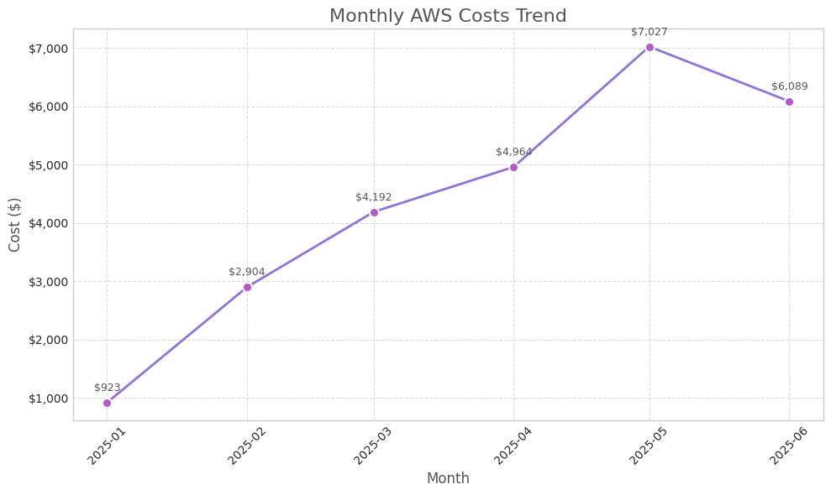
AWS Spending Over Time
Monthly AWS costs show a clear upward trend from
January to May 2025, with a slight decrease in June. This
pattern reflects the organization's cloud resource
utilization and growth.
Costs increased 7.6x from January ($923) to May ($7,027),
indicating significant expansion of cloud operations
June shows a 13.4% decrease from May's peak, suggesting
potential optimization efforts or reduced workloads
The steepest monthly increase occurred between February
and March, with costs rising by 44.3%
The average monthly cost across the first half of 2025 is
$4,350, with significant variance between months

Slide 6

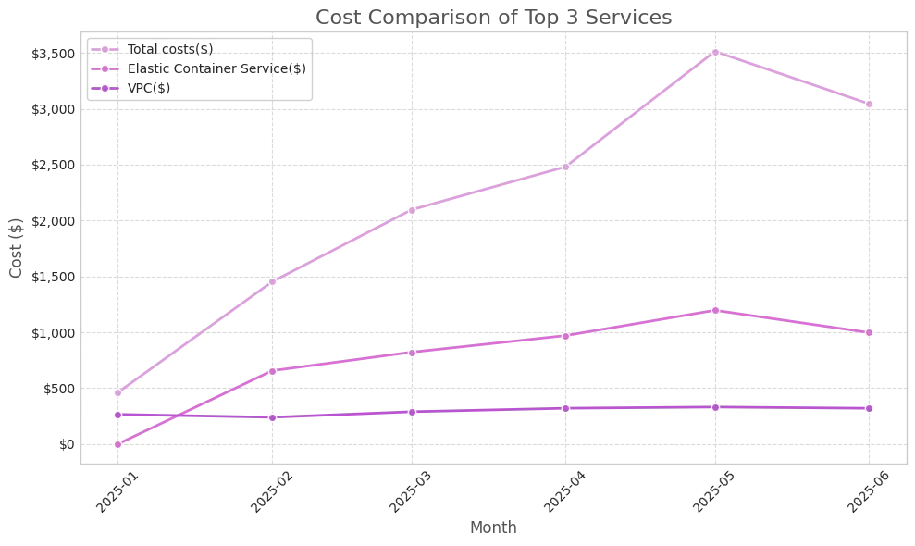
Service Cost Comparison
Comparing the cost trends of top services reveals distinct
usage patterns and growth rates. This comparison helps
identify which services are driving the overall cost
increases.
Elastic Container Service
Shows consistent growth throughout H1 2025, with the
steepest increase between April and May. This suggests
expanding containerized workloads and applications.
Virtual Private Cloud
Demonstrates more gradual cost increases, indicating stable
network infrastructure growth. The costs plateau between
May and June.
Claude 3.7 Sonnet
Shows the most dramatic fluctuations, with significant
increases in May followed by a decrease in June, suggesting
variable AI workload demands.

Slide 7


Elastic Container Service: A Closer Look
Elastic Container Service (ECS) is the largest cost driver,
accounting for $4,642.58 (35.6%) of total AWS
expenditure. This service provides orchestration for
Docker containers, allowing applications to be deployed
and managed at scale.
ECS costs have increased by 82% from January to June
2025, with the most significant jump occurring between
April and May. This suggests rapid expansion of
containerized workloads.
Right-size container instances based on actual resource
utilization patterns
Consider Fargate Spot for non-critical workloads to reduce
costs by up to 70%
Implement auto-scaling based on time schedules for
predictable workloads
Improve cost allocation with comprehensive tagging
strategy for containers

Slide 8


Virtual Private Cloud: Network Costs
Virtual Private Cloud (VPC) is the second-largest cost
driver at $1,766.15 (13.5%) of total AWS expenditure. VPC
provides the networking foundation for AWS resources,
enabling secure and isolated cloud environments.
Data Transfer
Cross-AZ and cross-region traffic typically accounts for 60-70%
of VPC costs
NAT Gateway
Hourly charges and data processing fees for private subnet
internet access
VPN Connections
Site-to-site VPN and client VPN endpoint hourly charges
Endpoint Services
Interface and gateway endpoints for private connectivity
Optimizing VPC costs requires careful architecture planning to
minimize cross-AZ data transfer and strategic placement of
resources to reduce network traffic costs.

Slide 9

Strategies for Cost Efficiency
Based on the analysis of AWS cost data, several
optimization strategies can be implemented to enhance
cost efficiency while maintaining performance.
Right-Sizing
Pricing Models
Match instance types to
Utilize Savings Plans for
workload requirements
predictable workloads
Implement automated scaling
Leverage Spot Instances for
based on usage
non-critical tasks
Architecture
Monitoring
Minimize cross-AZ data
Set up budget alerts and
transfer costs
anomaly detection
Implement lifecycle policies
Implement tagging for cost
for storage
allocation

Slide 10

Summary and Future Actions
Total AWS costs for H1 2025 reached $13,049, with a clear
upward trend indicating expanding cloud operations
Five services account for over 80% of costs, with ECS, VPC,
and AI services being the primary drivers
Monthly costs increased 7.6x from January to May, with a
slight decrease in June suggesting potential optimization
Recommended Next Steps
Implement detailed cost monitoring with service-specific
1
alerts
2
Conduct right-sizing analysis for ECS and EC2 resources
3
Evaluate Savings Plans for consistent workloads
Review network architecture to minimize cross-AZ data
4
transfer

